Slide 1
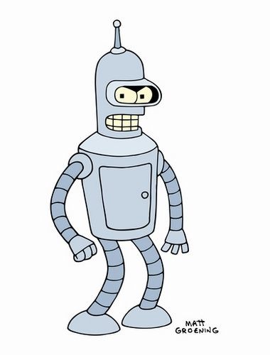
Artificial Intelligence https://people.eecs.berkeley.edu/~russell/slides/

Slide 2
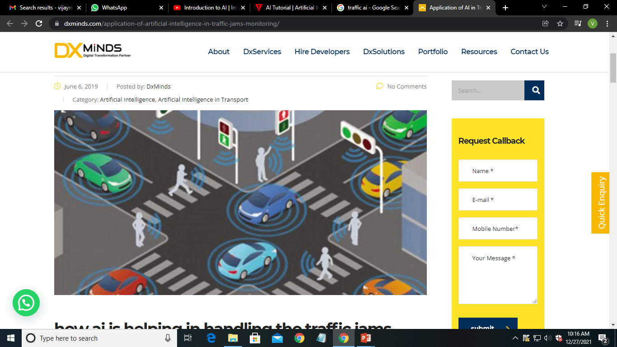

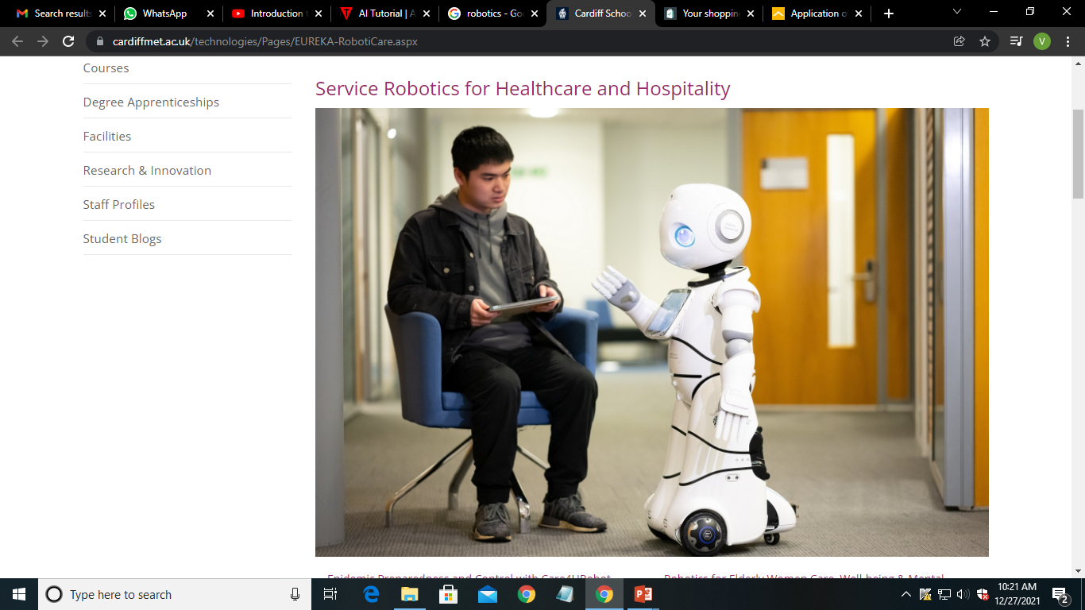
Why Artificial Intelligence?
With the help of AI, you can create such software or devices which can solve real-world problems very easily and with accuracy such as health issues, marketing, traffic issues, etc.
With the help of AI, you can create your personal virtual Assistant, such as Cortana, Google Assistant, Siri, etc.
With the help of AI, you can build such Robots which can work in an environment where survival of humans can be at risk.

Slide 3
Why Artificial Intelligence?
With the help of AI, you can create such software or devices which can solve real-world problems very easily and with accuracy such as health issues, marketing, traffic issues, etc.
With the help of AI, you can create your personal virtual Assistant, such as Cortana, Google Assistant, Siri, etc.
With the help of AI, you can build such Robots which can work in an environment where survival of humans can be at risk.
“AI will add 2.3 million jobs by 2021" ~ Gartner

Slide 4
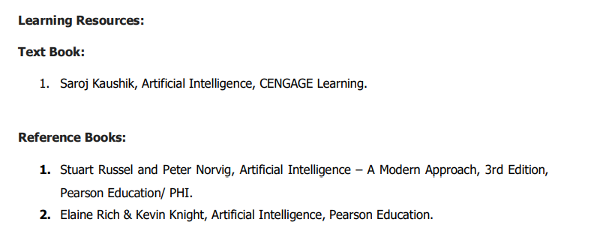

Slide 5
Introduction
What is AI?
The foundations of AI
A brief history of AI
The state of the art
Introductory problems

Slide 6
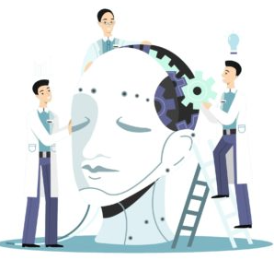
What is Artificial Intelligence?
Intelligence
Natural Intelligence
(Human)
Artificial Intelligence
(Machine/Device)
Artificial Intelligence is composed of two words Artificial and Intelligence, where Artificial defines "man-made," and intelligence defines "thinking power", hence AI means "a man-made thinking power."

Slide 7
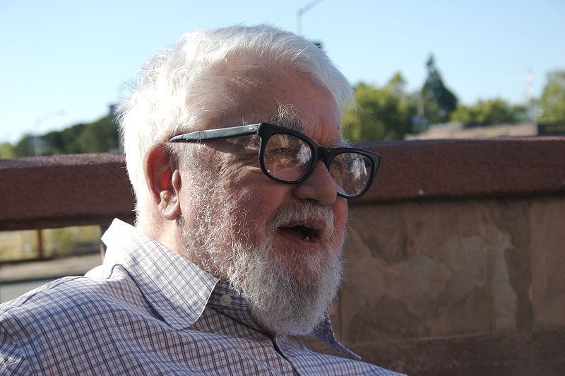
What is Artificial Intelligence?
It is the study of how to make computers do things which, at the moment, people do better.
In other words, it can be defined as the study of making of computer with the ability to mimic or duplicate the human brain functions.
John McCarthy coined the term in 1956, at
Massachusetts Institute of Technology,
defines it as "the science and engineering of
making intelligent machines”

Slide 8
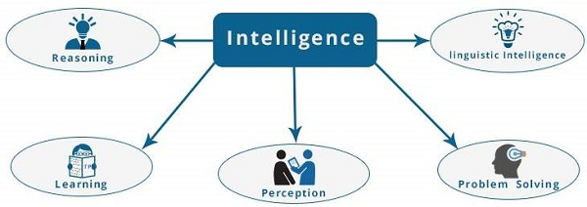
What is AI?
AI = Artificial + Intelligence
Intelligence: “ability to learn, understand and think” (Oxford dictionary)
Definition of AI:
AI is a study which makes the computers to do things which are, at the moment, at the hands of human beings.
Unnatural/simulated
Ability to understand Think & learn
Linguistic Intelligence − It is one’s ability to use, comprehend, speak, and write the verbal and written language. It is important in interpersonal communication.
Reasoning − It is the set of processes that enables us to provide basis for judgement, making decisions, and prediction.
Learning − It is the activity of gaining knowledge or skill by studying, practicing, being taught, or experiencing something. Learning enhances the awareness of the subjects of the study.
Problem Solving − It is the process in which one perceives and tries to arrive at a desired solution from a present situation by taking some path, which is blocked by known or unknown hurdles.
Perception − It is the process of acquiring, interpreting, selecting, and organizing sensory information.

Slide 9
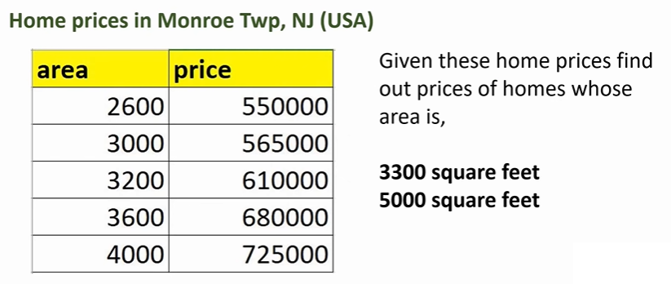

Slide 10
Crossbreeding of a lot of fields:

Slide 11
Intelligent systems
Goal of Artificial Intelligence
Not only to understand how does mind work? but also how to build intelligent entities?.
Engineering point of view:
- Solve real-world problems using knowledge and reasoning
- Develop concepts, theory and practice of building intelligent entities
- Emphasis on system building
Scientific point of view:
- Use computers as a platform for studying intelligence itself
- Emphasis on understanding intelligent behavior.

Slide 12
Categorization of Intelligent systems
Systems That Think Like Humans
Systems That Act Like Humans
Systems That Think Rationality
Systems That Act Rationality
 | Humanly | Rationally
Thinking | Thinking humanly — cognitive modeling. Systems should solve problems the same way humans do. | Thinking rationally — the use of logic. Need to worry about modeling uncertainty and dealing with complexity.
Acting | Acting humanly — the Turing Test approach. | Acting rationally — the study of rational agents: agents that maximize the expected value of their performance measure given what they currently know.

Slide 13
Categorization of Intelligent systems: Approaches
Systems that act like humans : Turing Machine Approach
Systems that Think like humans: The Cognitive Modeling Approach
Systems that Think rationality: The Laws of Thought Approach
Systems that Act rationality: The Rational Agent Approach

Slide 14
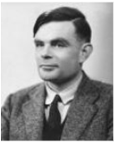
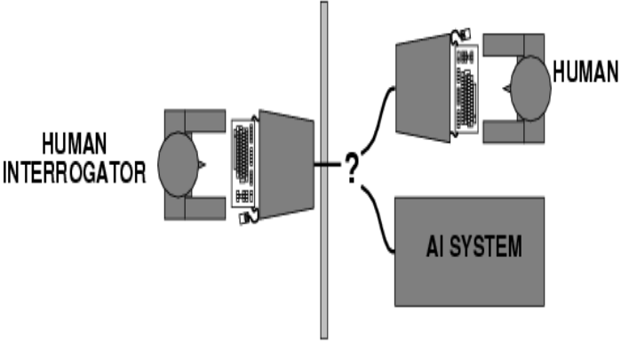
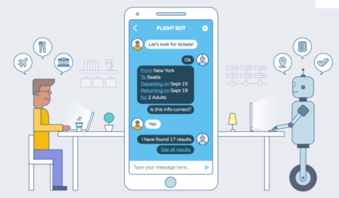
1.Acting humanly: The Turing Test approach
The first proposal for success in building a program and acts humanly was the Turing Test.
A Turing machine is a kind of state machine. At any time the machine is in any one of a finite number of states. Instructions for a Turing machine consist in specified conditions under which the machine will transition between one state and another.
AI Chat BOT

Slide 15
Acting humanly: The Turing Test approach
What capabilities would a computer need to have to pass the Turing Test?
Natural language Processing
Knowledge Representation
Automated Reasoning
Machine Learning
Turing Predicted that by the year 2000,machines would be able to fool 30% of human judges for five minutes.

Slide 16
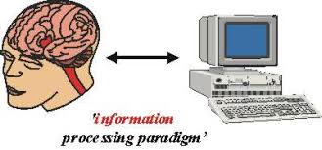
2. Systems that Think like humans: The Cognitive Modeling Approach
The interdisciplinary field of cognitive science brings together computer models from Artificial Intelligence and experimental techniques from cognitive psychology to try to construct precise and testable theories of the workings of the human mind.
And if we are going to say that a given program thinks like a human being, we must have some way of determining how human beings think.
For that, we need to get inside the actual workings of the human mind.

Slide 17
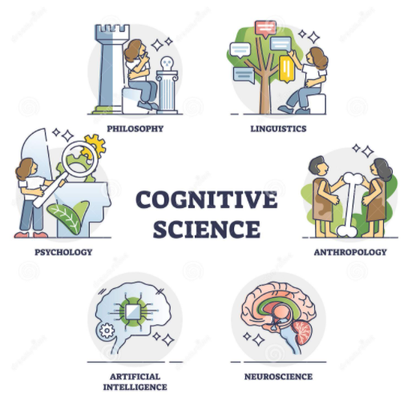
2. Systems that Think like humans: The Cognitive Modeling Approach
Cognitive science is the interdisciplinary study of mind and intelligence, embracing philosophy, psychology, artificial intelligence, neuroscience, linguistics, and anthropology.

Slide 18
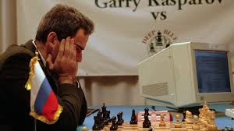
3. Thinking rationality: The Logical approach
Ensure that all actions performed by computer are justifiable (“rational”)
Rational = Conclusions are provable from inputs and prior knowledge
Problems:
Representation of informal knowledge is difficulty
Hard to define “provable” plausible reasoning
Combinatorial explosion: Not enough time or space to prove desired conclusions.
Facts and Rules in Formal Logic
Theorem Prover
Notes:
The Greek philosopher Aristotle was one of the first to attempt to codify ``right thinking'‘ . His famous syllogisms provided patterns for argument structures that always gave correct conclusions given correct premises
Logic field chapter 6.
There are two main obstacles to this approach.
It is not easy to take informal knowledge and state it in the formal terms required by logical notation, particularly when the knowledge is less than 100% certain.
There is a big difference between being able to solve a problem ``in principle'' and doing so in practice. Even problems with just a few dozen facts can exhaust the computational resources of any computer unless it has some guidance as to which reasoning steps to try first.

Slide 19
4. Systems that Act rationality: The Rational Agent Approach
System that acts rationally is the final category of intelligent system where by rational behavior we mean doing the right thing. Even if the method is illogical, the observed behavior must be rational.
Agent = Architecture + Program

Slide 20
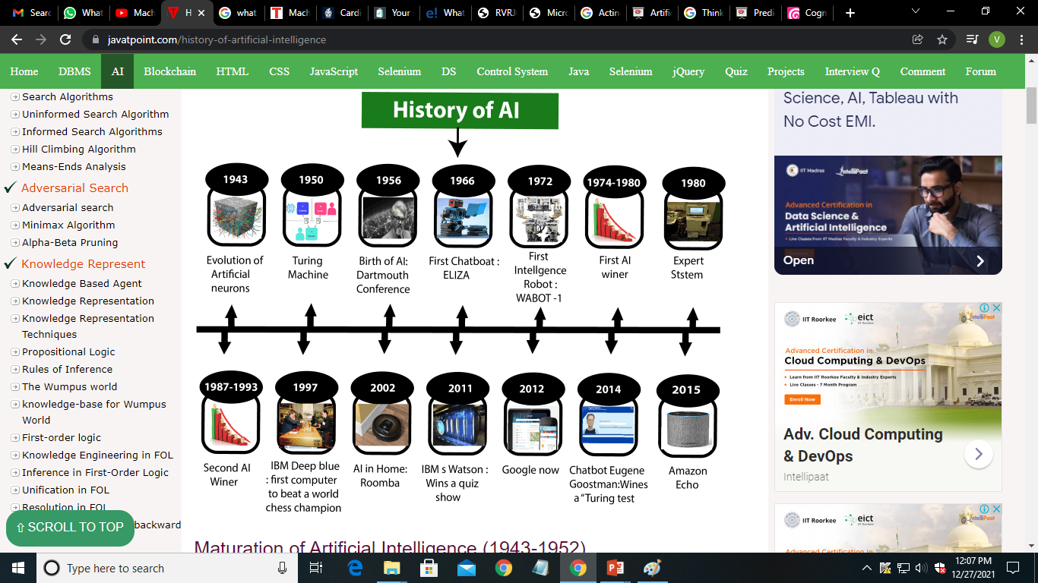

Slide 21
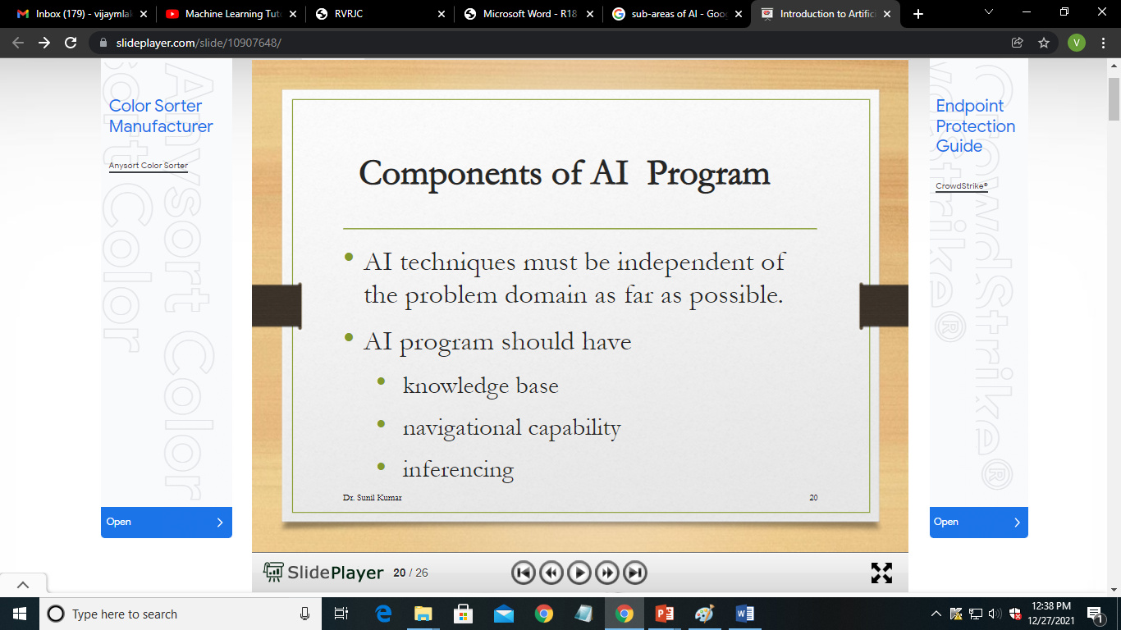

Slide 22
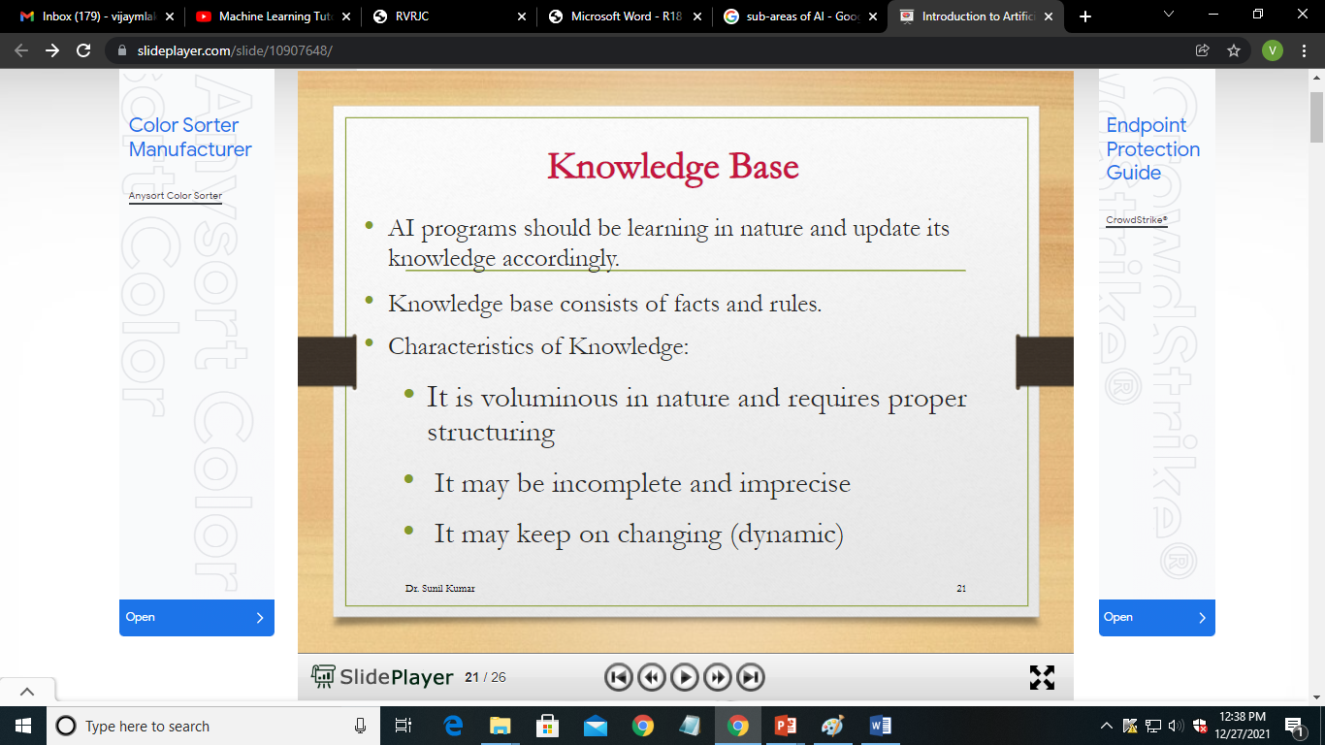

Slide 23
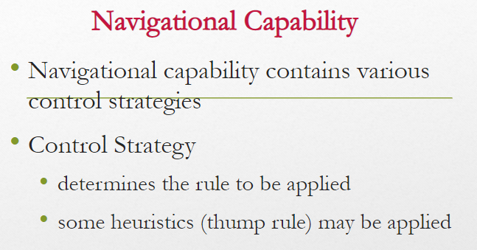

Slide 24
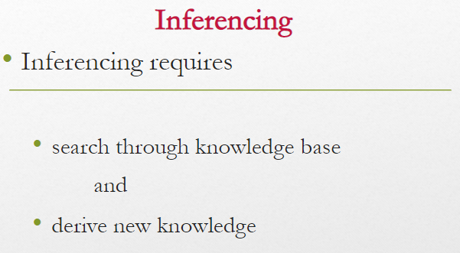

Slide 25
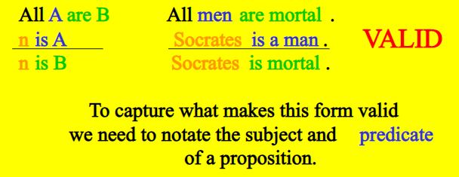

Slide 26
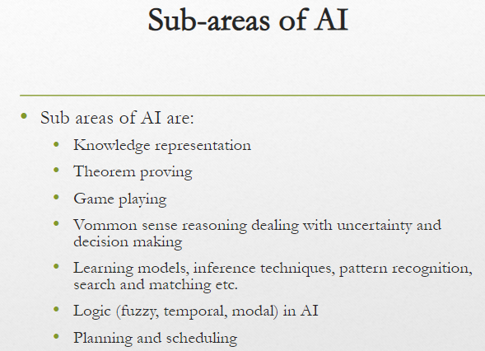

Slide 27
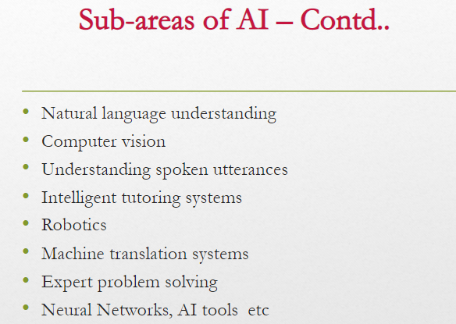

Slide 28
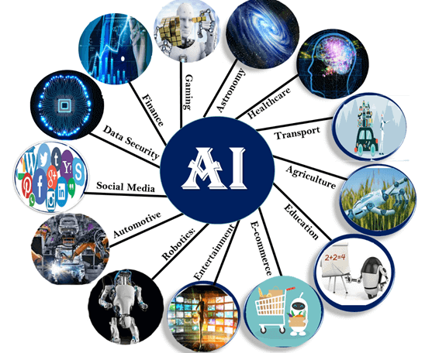
1.4 THE STATE OF THE ART
Following are some sectors which have the application of Artificial Intelligence:
1. AI in Astronomy
Artificial Intelligence can be very useful to solve complex universe problems.
AI technology can be helpful for understanding the universe such as how it works, origin, etc.
2. AI in Healthcare
Healthcare Industries are applying AI to make a better and faster diagnosis than humans.
AI can help doctors with diagnoses and can inform when patients are worsening so that medical help can reach to the patient before hospitalization.

Slide 29
3. AI in Gaming
The AI machines can play strategic games like chess, where the machine needs to think of a large number of possible places.
IBM’s DEEP BLUE became the first computer program to defeat the world champion in a chess match when it bested Garry Kasparov by a score of 3.5 to 2.5 in an exhibition match (Goodman and Keene, 1997).
4. AI in Finance
The finance industry is implementing automation, chatbot, adaptive intelligence, algorithm trading, and machine learning into financial processes.
5. AI in Data Security
Cyber-attacks are growing very rapidly in the digital world. AI can be used to make the data more safe and secure.
Some examples such as AEG bot, AI2 Platform, are used to determine software bug and cyber-attacks in a better way.
6. AI in Social Media
Social Media sites such as Facebook, Twitter, and Snapchat contain billions of user profiles, which need to be stored and managed in a very efficient way.
AI can organize and manage massive amounts of data. AI can analyze lots of data to identify the latest trends, hashtag, and requirement of different users.

Slide 30
8. AI in Automotive Industry
Some Automotive industries are using AI to provide virtual assistant to their user for better performance. Such as Tesla has introduced TeslaBot, an intelligent virtual assistant.
Various Industries are currently working for developing self-driven cars which can make the journey more safe and secure.
9. AI in Robotics:
Usually, general robots are programmed such that they can perform some repetitive task, but with the help of AI, we can create intelligent robots which can perform tasks with their own experiences without pre-programmed.
Humanoid Robots are best examples for AI in robotics, recently the intelligent Humanoid robot named as Erica and Sophia has been developed which can talk and behave like humans.
The iRobot Corporation has sold over two million Roomba robotic vacuum cleaners for home use.
10. AI in Entertainment
We are currently using some AI based applications in our daily life with some entertainment services such as Netflix or Amazon. With the help of ML/AI algorithms, these services show the recommendations for programs or shows.
11. AI in Agriculture
Agriculture is an area which requires various resources, labor, money, and time for best result. Now a day's agriculture is becoming digital, and AI is emerging in this field.

Slide 31
Agriculture is applying AI as agriculture robotics, solid and crop monitoring, predictive analysis.
12. AI in E-commerce
AI is helping shoppers to discover associated products with recommended size, color, or even brand.
13. AI in education:
AI can automate grading so that the tutor can have more time to teach. AI chatbot can communicate with students as a teaching assistant.
AI in the future can be work as a personal virtual tutor for students, which will be accessible easily at any time and any place.
14. Spam fighting:
Each day, learning algorithms classify over a billion messages as spam, saving the recipient from having to waste time deleting what, for many users, could comprise 80% or 90% of all messages, if not classified away by algorithms.
Because the spammers are continually updating their tactics, it is difficult for a static programmed approach to keep up, and learning algorithms work best (Sahami et al., 1998; Goodman and Heckerman, 2004).
15.Machine Translation
A computer program automatically translates from Arabic to English, allowing an English speaker to see the headline “Ardogan Confirms That Turkey Would Not Accept Any Pressure, Urging Them to Recognize Cyprus.”

